Slide 1



E commerce sales dash bord
View in Power BI
Last data refresh:
6/4/2024 4:45:09 AM UTC
Downloaded at:
6/4/2024 4:47:10 AM UTC

Slide 2
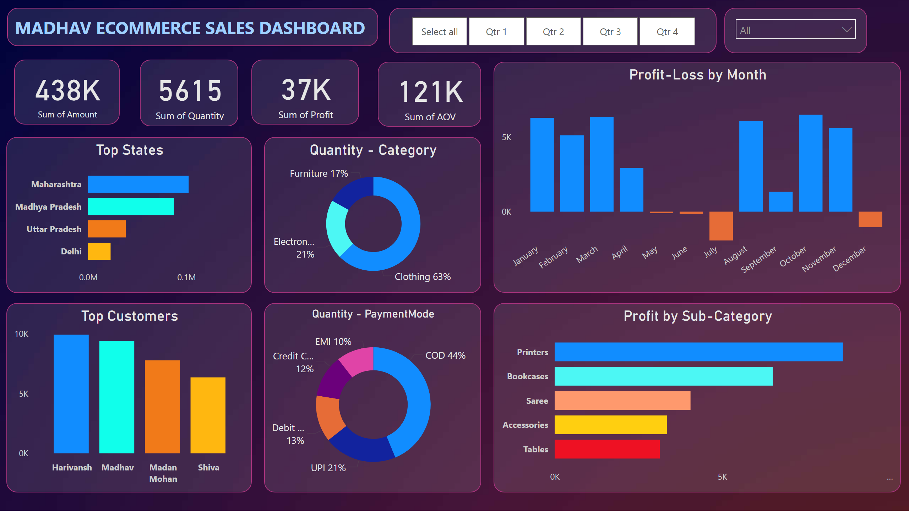
Page 1
Notes:
textbox
No alt text provided
Profit-Loss by Month
No alt text provided
Profit by Sub-Category
No alt text provided
Quantity - Category
No alt text provided
Quantity - PaymentMode
No alt text provided
card
No alt text provided
card
No alt text provided
card
No alt text provided
card
No alt text provided
Top States
No alt text provided
Top Customers
No alt text provided
slicer
No alt text provided
slicer
No alt text provided

